Slide 1
Data Analysis
For cost $10, higher ranks (1,2) ads: 2572 customers lower ranks (3,4,5) ads: 7428 customers.
Imbalance dataset? SMOTE
Are the people who see higher rank ads more likely to click the ads?
Are the people who see higher rank ads more likely to buy the policy?
We know that only a person who clicks can buy. But is it true that if a given type of people click more, then they will buy more?

Slide 2
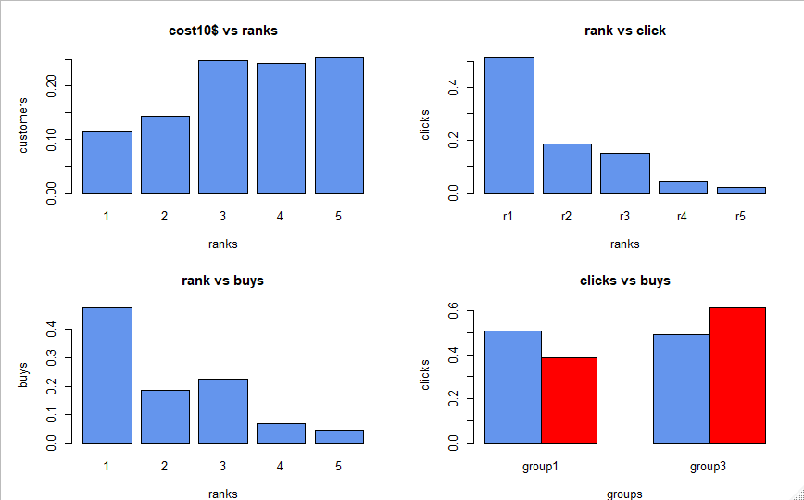
Data Analysis:

Slide 3
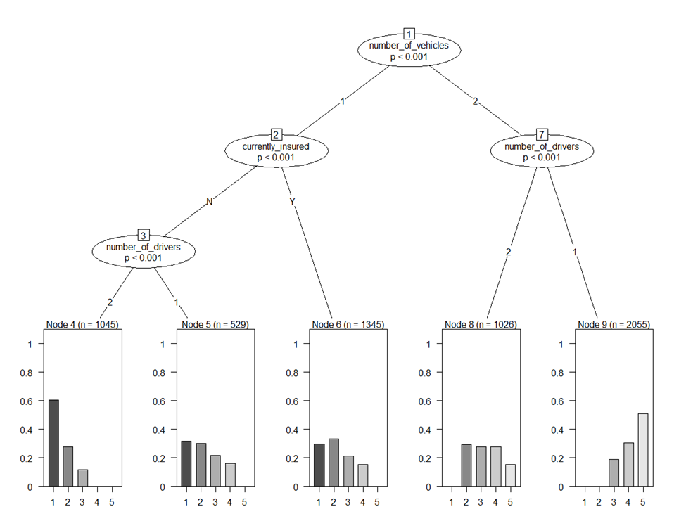
Data Analysis:
What do these tree plots indicate? Is the Marital status feature helpful?

Slide 4
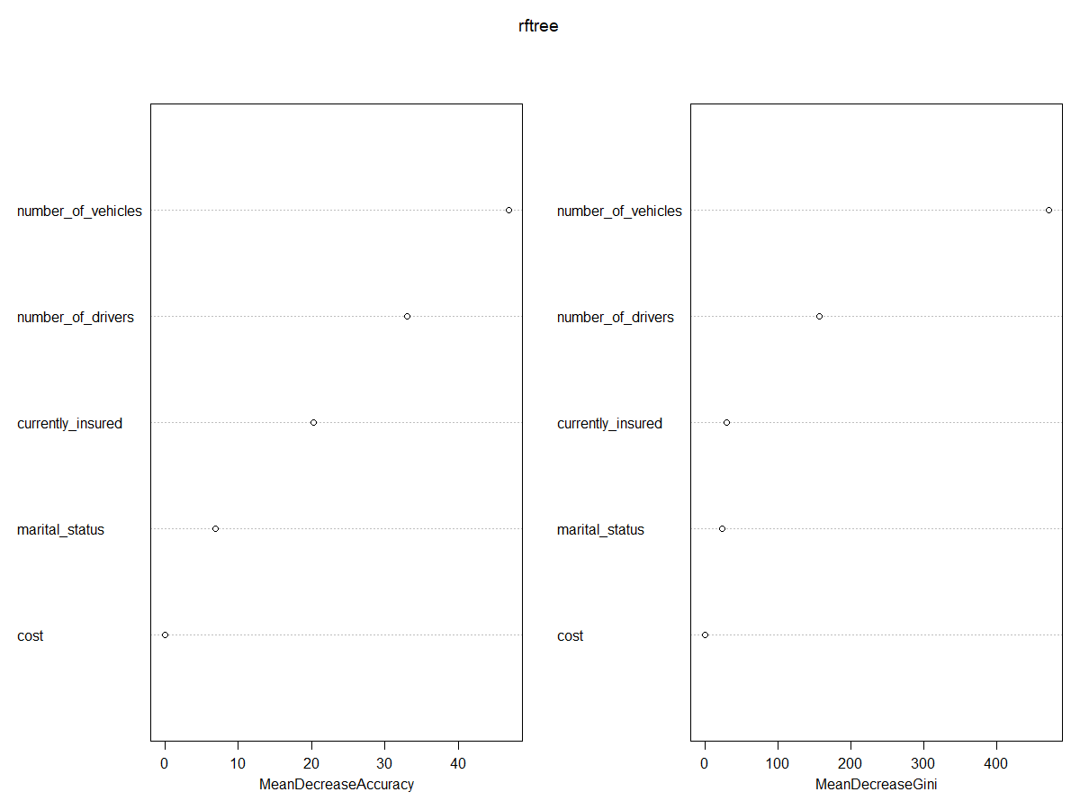
Data Analysis
vehicles | drivers | insured | More likely ranking
2 | 1 | Y/N | 5
1 | 2 | N | 1
1 | 1 or 2 | Y | 2
Identify the feature importance

Slide 5
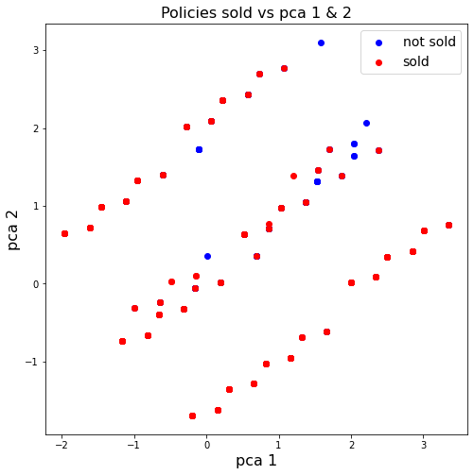
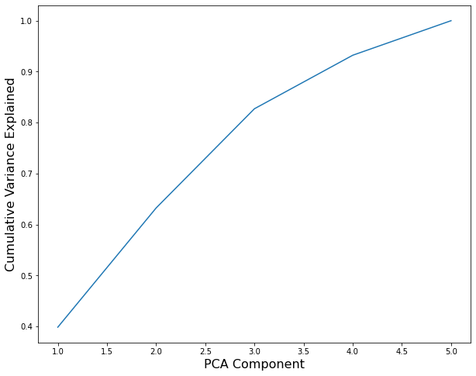
Data Analysis: Machine Learning
Supervised learning:
Linear Discriminant Analysis used to predict policy sold given ad clicked and type of person. 61% accuracy, 61% precision, 61% recall.
Random Forest Classifier used to predict ad clicked given rank of person. 73% accuracy, 74% precision, 73% recall.
Support Vector Machine used to predict rank given type of person. 42% accuracy, 52% precision, 42% recall. Low performance here caused us to try to predict a distribution of rank given type, rather than a single rank.
Unsupervised learning:
PCA: bad performance separating policies sold from unsold (given that ad was clicked). We have few enough variables already!
Clustering: similarly bad, less than 50% accuracy.

